Slide 1
Intuition for AdaBoost and Gradient Boosting

Slide 2
Ada Boost
This algorithm uses its predecessor to correct itself by paying more attention to mistakes done by the previous model.
The weights of the training instances is increased, so that the next model focuses more on the mistakes done by previous model.
The Next classifier is trained and acknowledges the updated weights and it repeats the procedure over and over again, until the problem is solved.

Slide 3
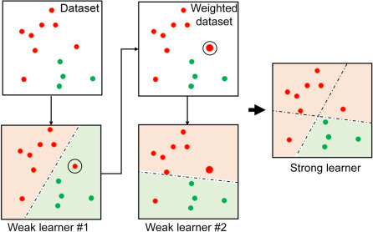

Slide 4
Adaboost Algorithm
Step 1: Initially assign equal weights to all observations
Step 2: Build a model on the subset of the data.
Step 3: Using the above model , predict the whole dataset
Step 4: Compute the error by comparing the predictions and actual value.
Step 5: Create the next model, assign higher weights to the data points which were predicted incorrectly.

Slide 5
Adaboost Algorithm Continued...
Step 6: Assign weights according to the error value. For instance , the higher error, the more is the weight assigned to the observation.
Step 7: Repeat the process until the error function doesn’t change, or the maximum limit of the number of estimators is reached.

Slide 6
AdaBoost Model Parameters
Base_estimators: specifies the algorithm to be used as a base learner
N_estimators: It defines the number of base estimators.
learning_rate : same impact as in gradient descent algorithm.
Max_depth: Maximum depth of the individual estimator.
N_jobs : indicates the system how many processors it is allowed to use.
random_state : makes the model’s output replicable.

Slide 7
Gradient Boosting
Gradient boosting works by sequentially adding the previous predictors under fitted predictions to the ensemble ensuring the errors made previously are corrected.
The main difference is that it tries to fit the new predictor to the residual errors made by the previous predictor.

Slide 8
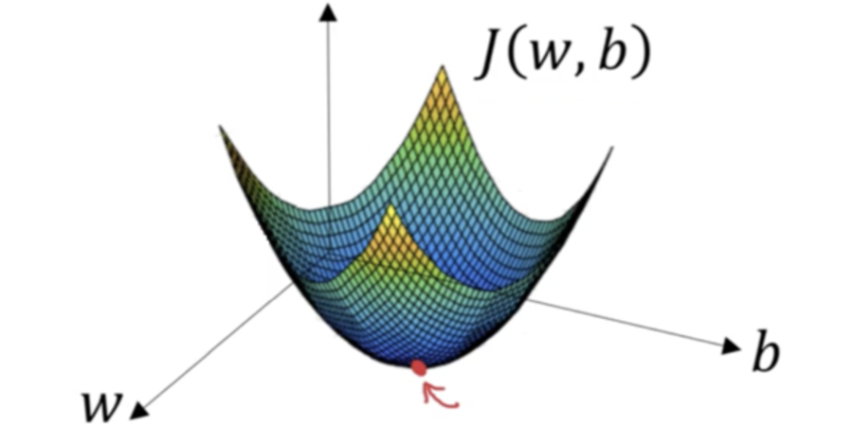
Gradient Descent
It is an optimization algorithm used to minimize some functions by iteratively moving in the direction of steepest descent as defined by the negative of the gradient.
In machine learning, gradient descent is used to update the parameters of the model.

Slide 9
Gradient Boosting Algorithm
Step 1: Deploy a model on a subset of data.
Step 2: Using this model, make predictions for the entire dataset.
Step 3: Compute the error by comparing the predictions and actual values.
Step 4: A new model is created using the errors calculated as target variables.

Slide 10
Continued...
Step 5: The predictions made by this new model are combined with the predictions of the previous.
Step 6: Compute the new errors using this predicted and actual value.
Step 7: Repeat the process until the error function does not change or the maximum value of the estimator is reached.

Slide 11
Gradient Boost Parameters
Min_sample_split: Minimum no. of observations required for splitting node.
Min_samples_leaf: Minimum samples required in the terminal or leaf node.
Min_weight_fraction_leaf: Defines a fraction of the total no. of observations.
Max_depth: Maximum depth of a tree. Used to control overfitting.
Max_lead_nodes: maximum number of terminal leaves in a tree.
Max_features: no. of features to consider while searching for the best split.

